Slide 1
Researching Project MongoDB and Mobile App
‘ Week2 Report ’
Lecturer: Mr. HEL Chanthan
Prepared by Mr. VANNAK Sovannroth
2019-2020

Slide 2
Outline
Planning for First Month.
Connecting driver to Mongo Shell.(Locally)
Starting to build sample backend.
Reference
PAGE 01

Slide 3
Planning for First Month
Activity (Start on 06.08.2020) | Thursday (Presentation day) | Friday | Monday | Tuesday | Wednesday (Meeting day)
Week 1 | Installation MongoDB (Shell and Compass) and connect localhost between Shell and Compass.(Locally) | Performing CRUD (Create, Read, Update, Delete) on Mongo Shell and MongoDB Compass. | Creating MongoDB Atlas account and connect it to Mongo Shell or MongoDB Compass, and Driver (Node.js).(Cloud) | Installation Visual Studio Code and connect driver to MongoDB Atlas.(Cloud) | Connecting sample Backend to MongoDB Cluster and storing Products in the Database.
Week 2 | Connecting driver to Mongo Shell.(Locally) | Starting to build sample backend connect with or without MongoDB Atlas. | Build creating, editing and deleting Products on server. | Transmitting and fetching data to/from the Database. | Creating Login and Signup. (Email and password)
Week 3 | Learning template Bootstrap 4 | Starting to build backend for project. | Creating Login and Signup. | User management: • Create new user • Reset user password • Delete and edit user | Manage new category: • Create new category • Edit and delete exiting categories.
Week 4 | Manage news: • Post news • Edit news • Delete news | Manage Info: • Logo • Name • Contact info • Map • Social | Create Dashboard | Manage Calculate: • Addition • Subtraction • Multiplication • Division | Get data from Sensors and Calculate.
PAGE 02

Slide 4
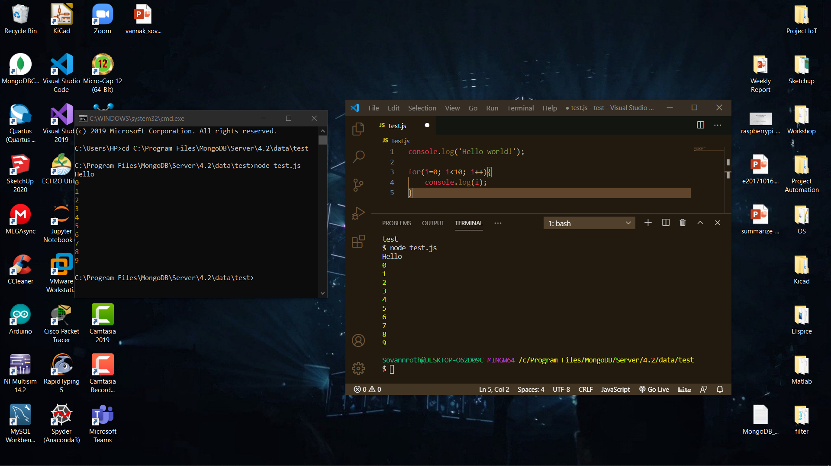
Connecting driver to Mongo Shell.(Locally)
Connecting
How to start server
On Mongo Shell use two cmd or terminal, one use command >mongod --port 27027 and next one use command >mongo --port 27027.(Port define by user)
On Driver(Node.js), we create Folder as C:\Program Files\MongoDB\Server\4.2\data\Sample Backend. And connecting by ‘mongodb://localhost:27027/test’
1) Run "npm install" in the extracted project folder
2) Run "npm start" to start the React development server
3) Keep 2) running and additionally run "npm run start:server" in a new terminal/ command prompt window (also in the project folder) to start the Node.js server.
PAGE 03

Slide 5
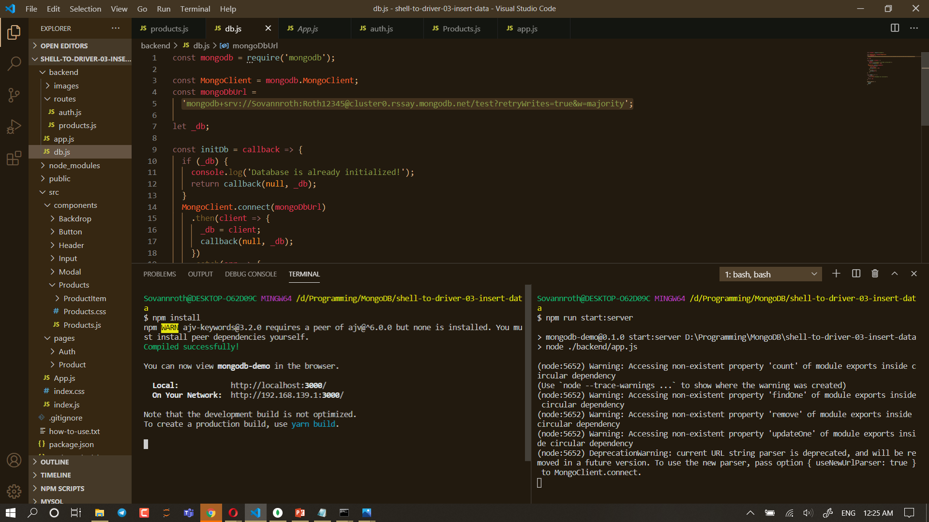
Connecting driver to Mongo Shell.(Locally)
Running server
PAGE 04

Slide 6
Starting to build sample backend
https://github.com/Chanthan89/Smart-Irrigation/tree/master/Weekly%20Presentation/August-2020/VANNAK%20Sovannroth/Sample%20Backend
Reference
https://www.w3schools.com/nodejs/default.asp
https://www.tutorialsteacher.com/nodejs/access-sql-server-in-nodejs
https://www.geeksforgeeks.org/nodejs-tutorials/
PAGE 05

Slide 7
Thank You!

